Slide 1


Covid-19 Detection from Chest X-ray Images using Deep Learning CNN models
MEMBERS
Deeti Hothrik - 1806080
Sudhanshu Kumar - 1806083
Shubhangi Singh - 1806179
PROJECT SUPERVISOR
Dr. Shyam Singh Rajput
(Astt. Prof. CSE Dept)

Slide 2
INDEX
Introduction
Data Set Description
Proposed FrameWork
Evaluation Parameters
Experimental Results
Challenges
Conclusion
References

Slide 3
INTRODUCTION
Since December 2019, a novel coronavirus (SARS-Cov-2) has spread across whole world. To detect this virus, RT-PCR was done as main screening method for COVID-19 .
However, total positive rate of RT-PCR for throat swab samples is reported to be 30% to 60%.
Chest radiography imaging (e.g., X-ray or computed tomography (CT) imaging) is easy to perform with fast diagnosis.
Chest CT has a high sensitivity for diagnosis of COVID-19 and X-ray images show visual indexes correlated with COVID-19.
A Deep Learning framework was employed to predict COVID-19 from Chest X-ray images which directly predicts the COVID-19 from raw images without any feature extraction.
Deep learning models especially CNN models have been used for these approaches.

Slide 4
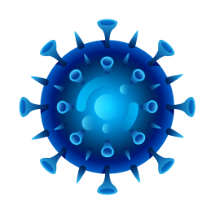
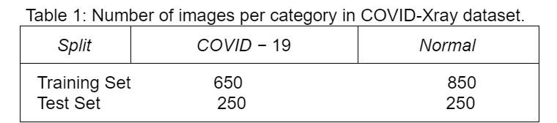
DATA-SET DESCRIPTION
01. SOURCES-
Data was collected from public sources which was released publicly in this GitHub repository - https://github.com/ieee8023/covid-chestxray-dataset and Kaggle.
Data was available from - 3 May, 2020
Our dataset consists of 2000 images out of which 1500 images are for training set(under folder Train which consist of 650 Covid and 850 Normal Images) and the rest 500 images are for testing set(under folder Test which consist of 250 Covid and 250 Normal Images).

Slide 5
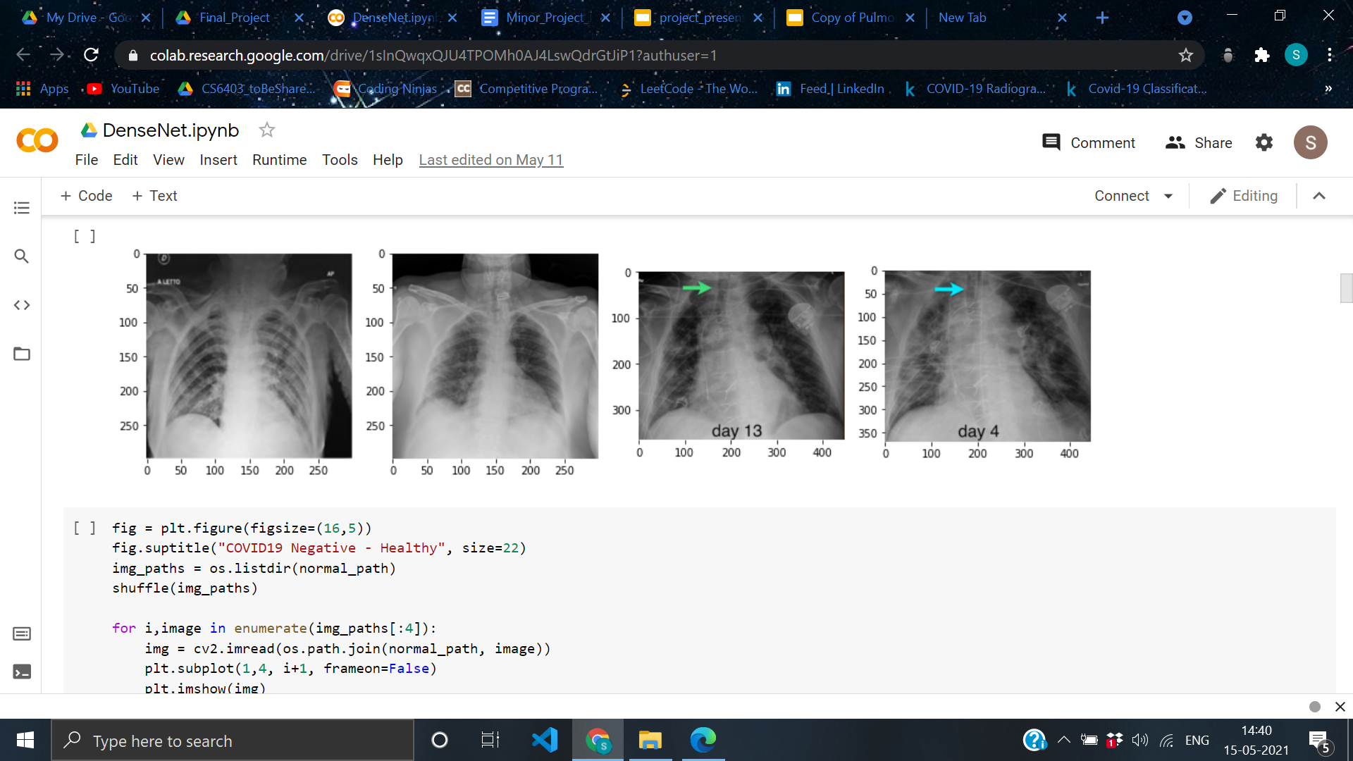
02. SAMPLE DATA-
03. DATA AUGMENTATION-
Since there is limited number of X-ray images available so in order to overcome the scarcity issue, certain strategies are adopted:
We used data augmentation to create transformed version of images (such as flipping, small rotation,adding small amount of distortions) to increase the sample size.

Slide 6
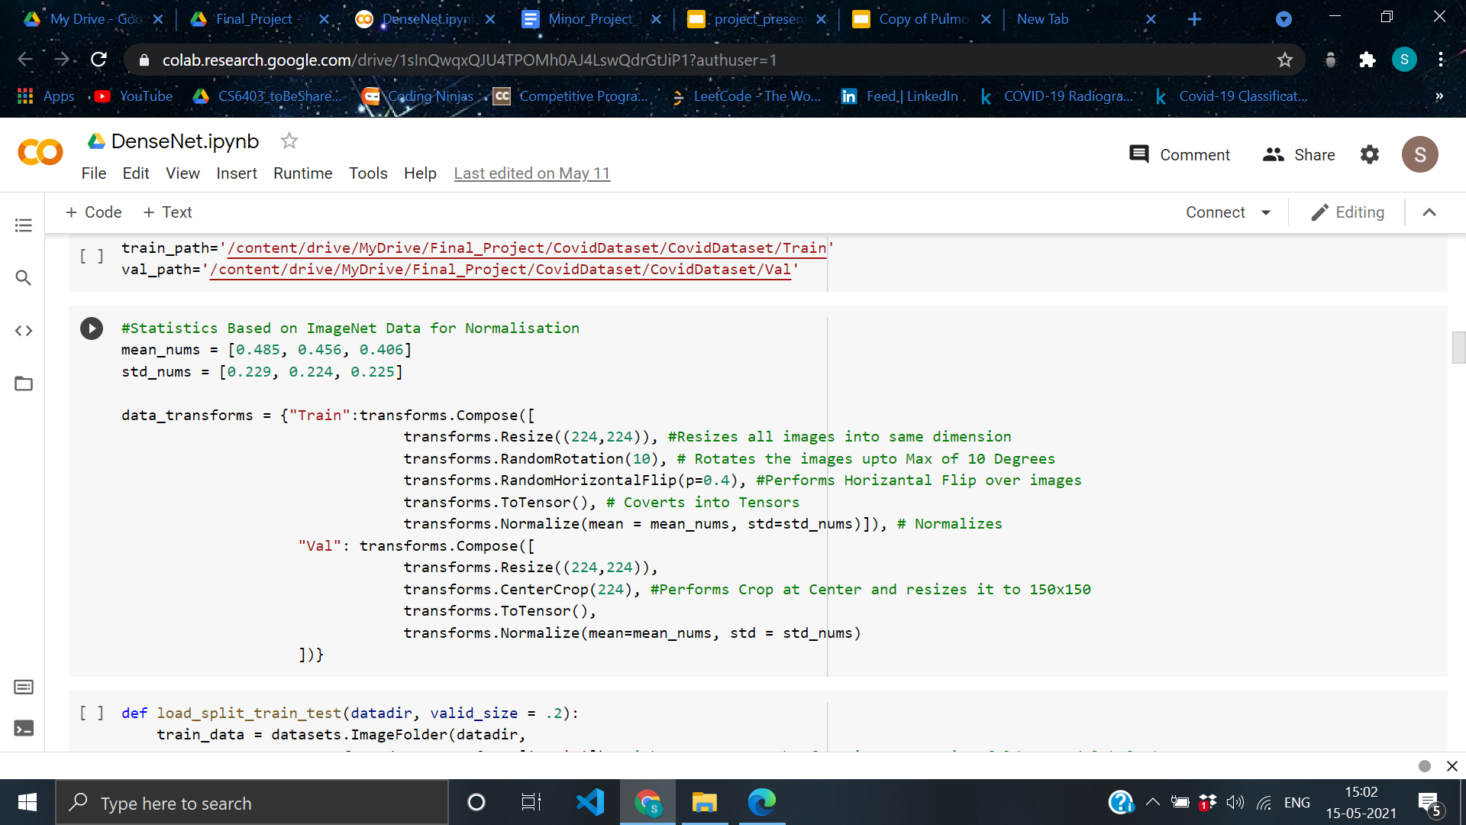
Instead of training these models from scratch, we fine-tune the last layer of pre-trained versions of these models on ImageNet.So, models can be trained with less-labelled samples from each class.
There is wide variation in resolution of image so fixed them to 224x224 size.
All training images are normalized to same distribution to make model less sensitive to dynamic range.

Slide 7
PROPOSED FRAMEWORK
Transfer learning is mainly useful for tasks where enough training samples are not available to train a model from scratch.
We only fine-tune the last layer of convolutional neural networks, and essentially used the pre-trained models as feature extractor. The models implemented are:
ResNet-18
ResNet-50
DenseNet-121
VggNet-16
The evaluation metrics are in the workflow.
Training Set
COVID-19
X-ray Images
MODELS
1.ResNet 18
2.ResNet 50
3.DenseNet-121
4.VggNet-16
Augmentation
Trained Model
Data-Splitting
Parameters
1.Precision
2.Recall
3.Accuracy
4.Specificity
5.F1-Score
Testing Set

Slide 8
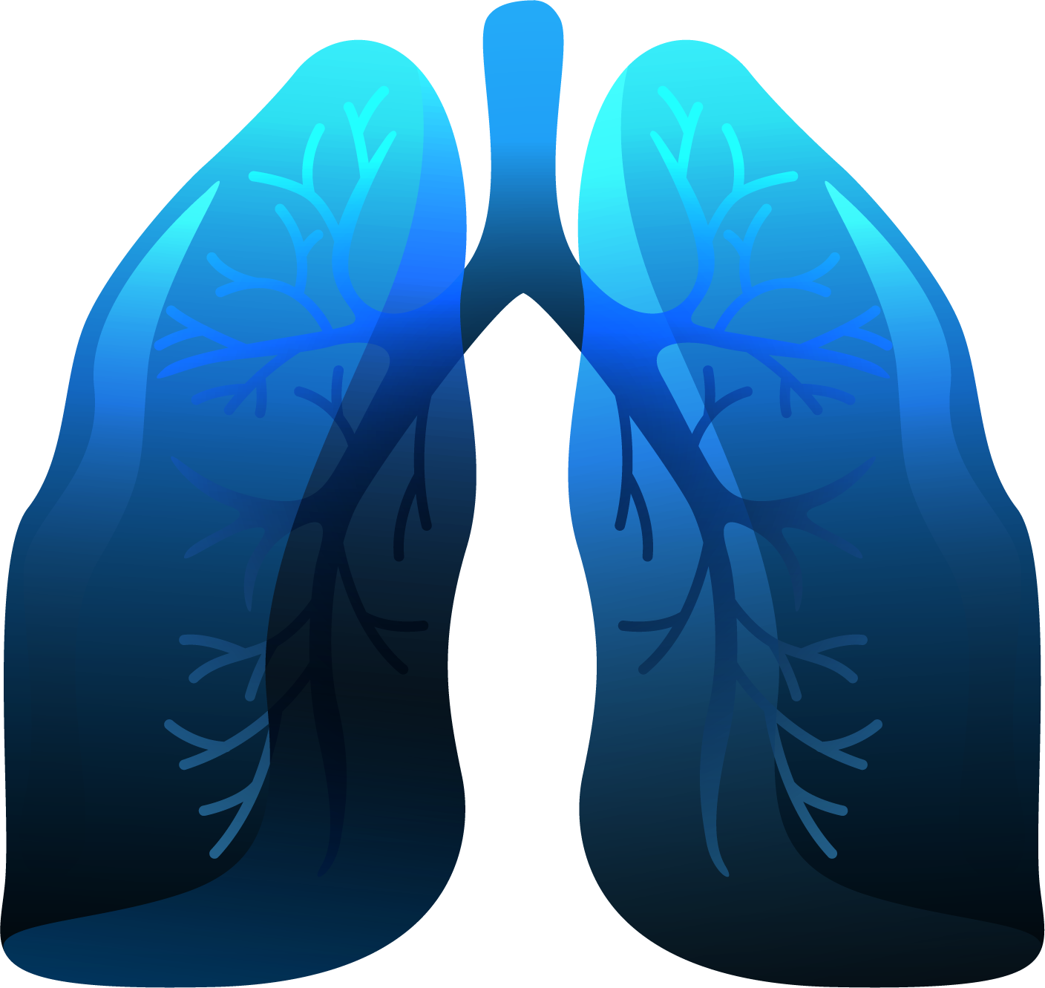
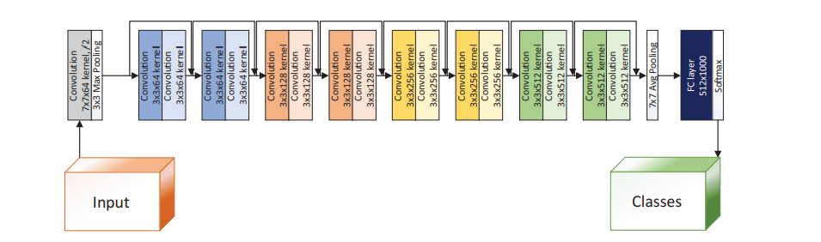
01. COVID-19 DETECTION USING RESIDUAL CONV-NET- RESNET 18 AND RESNET 50 -
The core idea behind ResNet is introducing a identity shortcut connection that skips one or more layers. These help to make changes in gradient update for layers easier.
ResNet 50 is similar to ResNet 18 but having more layers.
Architecture of ResNet 18 Model

Slide 9
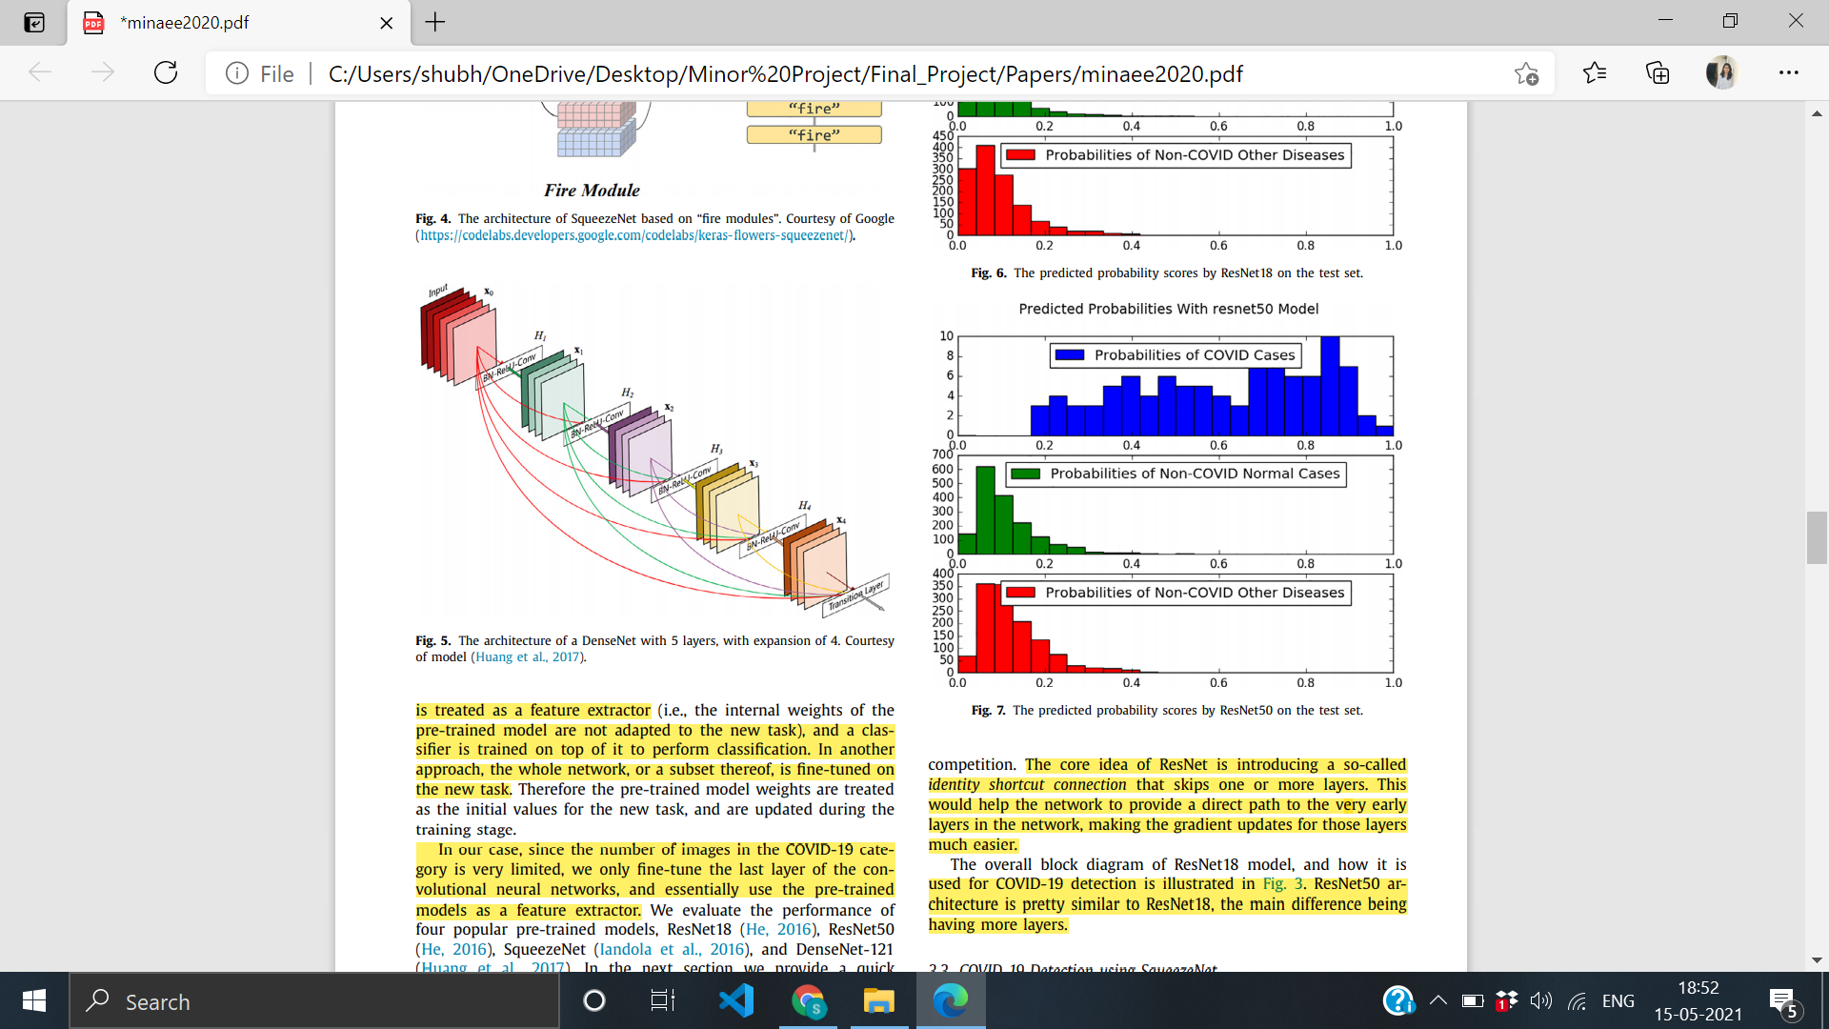
02. COVID-19 DETECTION USING DENSENET-121-
In DenseNet, each layer receives additional inputs from all preceding layers and passes its own feature maps to subsequent layers. Since each layer receives input from preceding layers, network can be thinner and compact i.e, number of channels can be fewer resulting in higher computational efficiency.
Architecture of DenseNet model

Slide 10
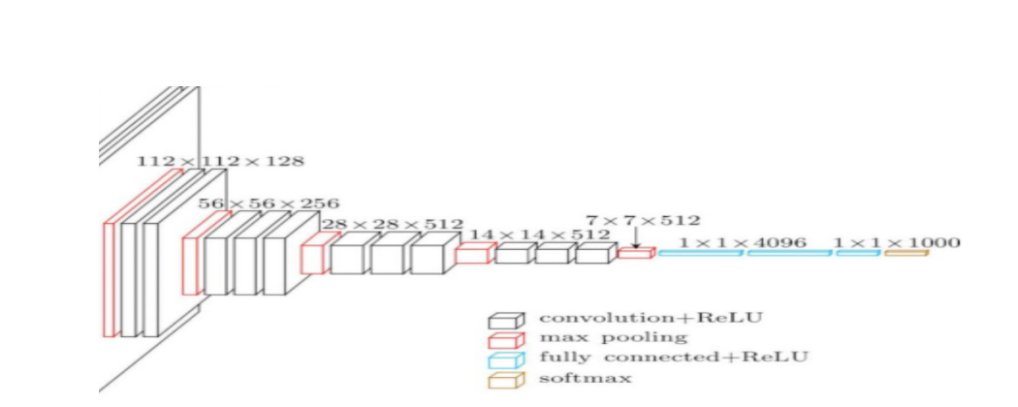
03. COVID-19 DETECTION USING VGGNET-16-
It makes the replacement over AlexNet by replacing large kernel sized filters (11 and 5 in the first and second convolutional layers) by multiple 3x3 kernel sized filters one after the other.
The convolutional stride is being fixed to 1 pixel with 2 x 2 max-pooling window and there are 16 layers.
Architecture of VGGNet-16 model

Slide 11
EVALUATION PARAMETERS
01. ACCURACY- It is the ratio of correctly labelled subjects to the whole pool of subjects.
Accuracy= (TP+TN)/(TP+TN+FP+FN)
02. PRECISION - It is the ratio of correctly positive labelled by our model to all positively labelled.
Precision = TP/(TP+FP)
03. RECALL / SENSITIVITY - It is the ratio of correctly positive labelled by our model to the actual true positive.
Recall = TP/(TP+FN)
04. F1-SCORE- It is the harmonic mean of precision and recall.
F1-SCORE = 2*(Recall* Precision)/(Recall+Precision)
05. SPECIFICITY - It is the ratio of correctly negative labelled to all positive and negative labelled classes.
Specificity = TN/(TN+FP)

Slide 12
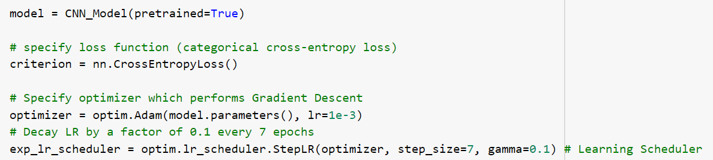
EXPERIMENTAL RESULTS
01. HYPER-PARAMETERS-
Loss Function: Cross Entropy Loss Function
Optimizer: Adam
Learning Rate: 1e-3
Batch-size: 32
Number of Epochs: 10
All images are down-sampled to 224 x 224 before fed to neural network.

Slide 13
02. EVALUATION METRICS -
ACCURACY ON TESTING DATASET-
 | Implemented Model | Results in Papers
ResNet-18 | 70.13% | 98.9% ^{[1]}
DenseNet-121 | 84.55% | 97.6% ^{[1]}
VggNet-16 | 86.24% | 83.0% ^{[2]}
ResNet-50 | 92.32% | 90.6%^{[2]}
In the above table, VggNet-16 and ResNet-50 shows better result in implemented model as compared to results proposed by papers .

Slide 14
AVERAGE PRECISION, RECALL, F1- SCORE and SPECIFICITY -
 | Precision | Recall | F1-Score | Specificity
VggNet-16 | 0.475 | 0.572 | 0.52 | 0.389
ResNet 50 | 0.519 | 0.592 | 0.553 | 0.471
DenseNet -121 | 0.555 | 0.444 | 0.493 | 0.656
ResNet-18 | 0.713 | 0.656 | 0.683 | 0.745

Slide 15
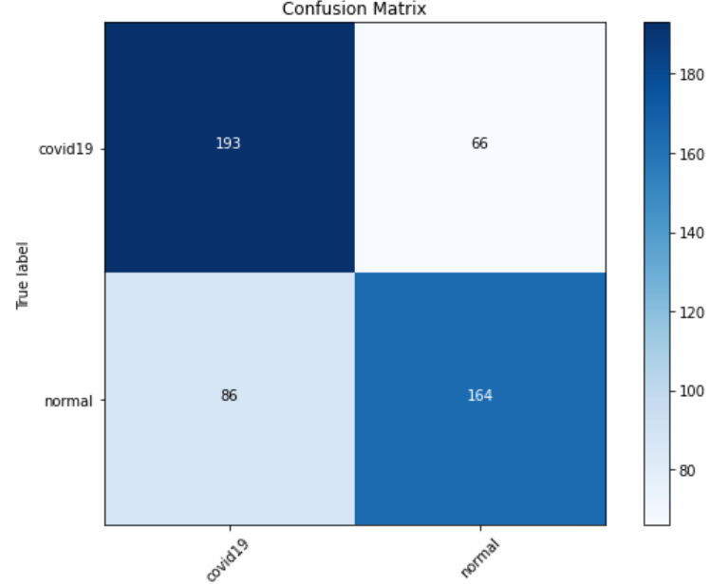
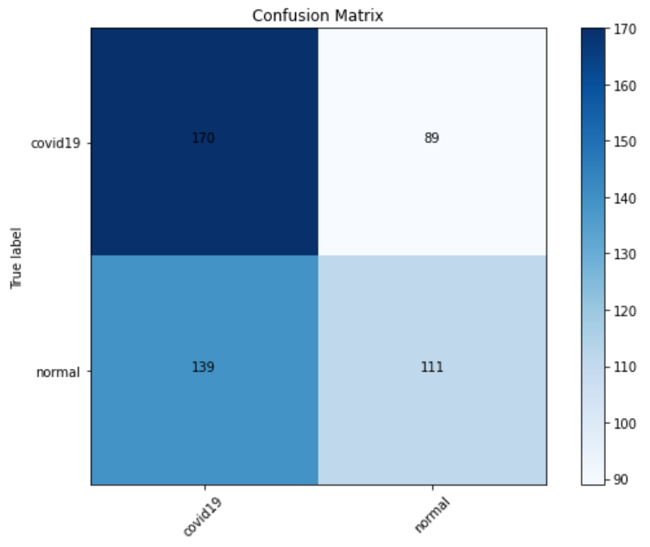
CONFUSION MATRIX -
ResNet 18
DenseNet-121

Slide 16
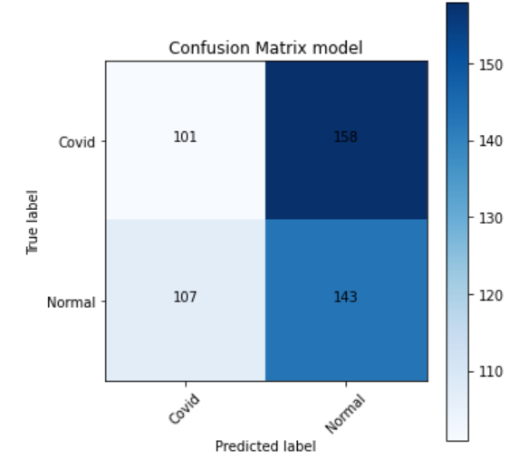
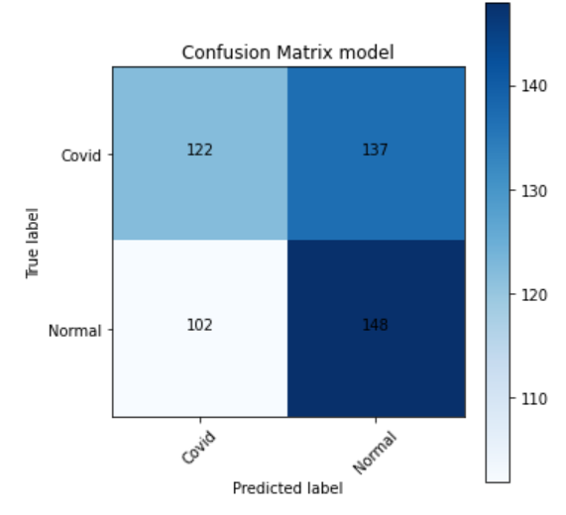
VggNet-16
ResNet-50

Slide 17
CHALLENGES
Choosing X-ray images Vs Computer tomography(CT) images as our dataset
We chose X-ray images over CT images because it’s cheap and readily available
Limited data-size(approx 2000) not enough to train a deep learning model accurately
We used Data Augmentation method to resolve this
Limited time and resources to train a deep learning model
We performed Transfer learning i.e used pre-trained model and performed fine-tuning(from ImageNet)
Fixed resolution of images to 224 x 224
Choosing suitable learning rate.(eg - 0.0001^{[1]}, 2e-4^{[2]}, etc)
We chose 1e-3 as learning rate which results in better accuracy except DenseNet

Slide 18
CONCLUSION
We implemented as well as compared 4 different CNN models and on basis of accuracy found their relative ordering as follows :
ResNet-18 < DenseNet-121 < VggNet-16 < ResNet-50
Choosing suitable learning rate depending upon amount and type of data is important to enhance result
We also concluded, Data Augmentation as a useful technique in CNN models
We improved accuracy of VggNet-16 - 86.24%( > 83% ^{[2]} )
ResNet-50 is our best model with accuracy 92.33%( > 90.6 % ^{[2]} )
We can increase accuracy of our best model ResNet-50 furthermore using CT - imaging which is going to be future scope of our project.

Slide 19
REFERENCES
Shervin Minaee,Rahele Kafieh, Milan Sonka,Shakib Yazdani, Ghazaleh Jamalipour Soufie- Deep-COVID: Predicting COVID-19 from chest X-ray images using deep transfer learning ; doi:10.1016/j.media.2020.101794
Linda Wang, Zhong Qiu Lin and Alexander Wong - COVID-Net: A Tailored Deep Convolutional Neural Network Design for Detection of COVID-19 Cases from Chest X-Ray images ; doi: arXiv:2003.09871v4
Yang, Y., Yang, M., Shen, C., Wang, F., Yuan, J., Li, J., Zhang, M., et al., 2020. Laboratory diagnosis and monitoring the viral shedding of 2019-nCoV infections. MedRxiv. Zeiler, M., Fergus, R., 2014. Visualizing and understanding convolutional networks. In: European Conference on Computer Vision. Springer, Cham
Kong, W., Agarwal, P.P., 2020. Chest imaging appearance of COVID-19 infection. Radiology: Cardiothorac. Imaging ; doi:10.1148/ryct.2020200028. Krizhevsky, A., Sutskever, I., Hinton, G.E., 2012. ImageNet classification with deep convolutional neural networks. Adv. Neural inform. Process.Syst

Slide 20

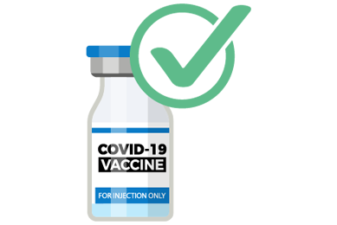
THANKS!!
With the daily cases of COVID-19 rising at peak , it is necessary to follow safety protocols. A quick revision to necessary protocols are -
Wear masks when you go in public places
Wash your hands often with soap and water for at least 20 seconds .
Practice social- distancing by keeping at least 6 feets from others when out in public places.
Get yourself vaccinated.

